Slide 1

Dr. M. Yusuf Ms. Nancy R
PHD (USA), BE (India) MBA (USA), SAP – HCM
BE (India) (Germany), LLB (India)
Chairman CEO

Slide 2
MENA GROUP - INTRODUCTION
Fully Integrated and Specialized Companies
Over 2000 Employees
Global Operations in over 10 countries with offices/facilities
Annual revenues in excess of $ 300 Million

Slide 3

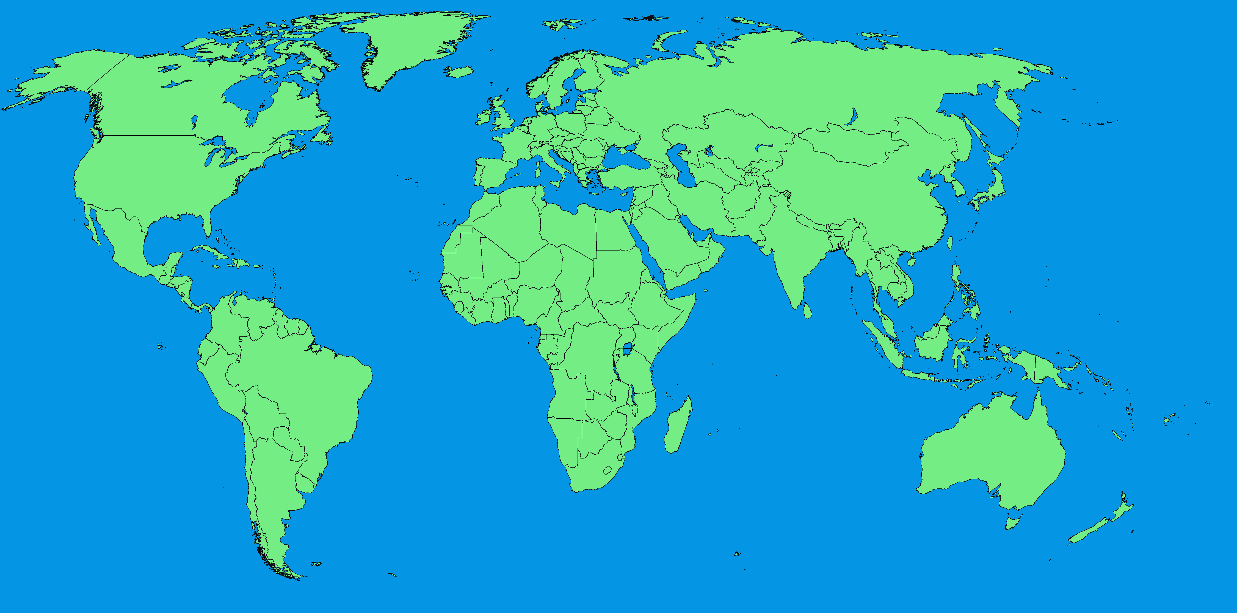
Global Presence
Kuwait
Kabul, Afghanistan
2 Offices in Nepal
Karachi, Pakistan
Basra, Iraq
Jeddah, Riyadh, Dammam; KSA
Doha, Qatar
Manila, Philippines
Dubai & Sharjah, UAE
Dhaka, Bangladesh
Colombo, Sri Lanka
India:
HQ – Mumbai
Odisha
Kerela
Chennai
Goa
Kolkata
Tamilnadu
Telanganna

Slide 4
Business Lines
Support Services: Defense Contracts
Specialist Support Services
Catering Services
Facilities Management
Engineering, Contracting & Maintenance
Marine Engineering, Crew Management ,Ship Chartering
Industrial Training and Skill Development
Information Technology
Human Resource Development & Placement Services
Job Portal

Slide 5
BUSINESS LINE - SHARE

Slide 6
Support Services:
SPONSORSHIP SERVICES
MENA offers sponsorship and support services to contractors operating in the Arabian Gulf. Now, with over 20 years experience MENA has gained a strong foot-hold in these countries and has its own offices, facilities and staff who have vast knowledge and rich experience in respective country.
Services include the entire process related to obtaining residence permit/visas for the client and all his personnel. This ranges from establishing the labor file to obtaining the travel permits complying with local Government regulations in regard to visas/documents.

Slide 7
Support Services:
Facilitating offices/accommodation/local logistic s for client’s staff and field staff
Catering/Facility Management/Security Services / Medical facilities in compliance with local laws
Insurance – DBA/WCP/3RD Party Cover and other insurance as per demand
Assigning a dedicated senior/middle level management team for coordination/communication with client, thus ensuring 24 x 7 service, including weekends and Public holidays
Deployment of TCN from India/Philippines/Bangladesh/Sri Lanka/Nepal and other nationalities, including Arab nationals, as per need.
Scheduling rotation leave
Personal data maintenance and payroll management
Air tickets
PPE
Family assistance in the country of origin of employee

Slide 8
Specialist Support Services
Pre-commissioning/Commissioning/Testing and Annual Maintenance consisting of Engineers and Field Technicians
Industries served largely consist of Oil/Gas/Refinery/Petrochemical/Chemical
/Power projects worldwide
Multinational team, consisting of European/Filipino/Asian

Slide 9
Specialist Support Services
Polypropylene Plant
Client: Tecnimont SpA-Italy
Location: Russia
Qatar Gas Plant
Client: Qatar Gas Plant
Location: Qatar
Service: Field Operations
Service: Mechanical Construction
Combat Support Service
Client: General Dynamics
Location: KSA
Service: Camp Maintenance Services
Gas Field (Offshore)
Client: Confidential
Location: Nigeria
Service: Mechanical Maintenance

Slide 10
Specialist Support Services
Mohahemdia Refinery
Client: Mohahemdia Refinery
Location: Morocco
Service: Mechanical Maintenance
Polypropylene Plant
Client: Trinfuo
Location: Brazil
Service: Commissioning
DHDS Plant
Client: Indian Oil Corporation
Location: India
AGIP Gas Plant
Client: AGIP Gas Plant
Location: Nigeria
Service: Pre-Commissioning, Commissioning & Testing-Mechanical, Electrical & Instrumentation
Service: Plant Operation & Maintenance

Slide 11
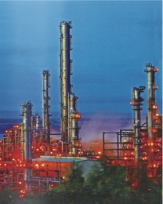

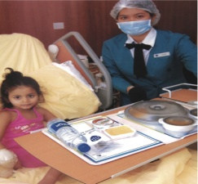

Catering Services : JV With ALBERT ABELA
Industrial Catering : Onshore & Offshore,
Construction Sites, Factories
Airport & In Flight Catering
Institutional Catering : Hospitals & Schools
Corporate Catering : Events

Slide 12
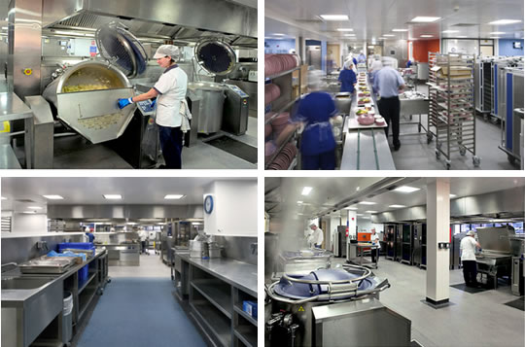
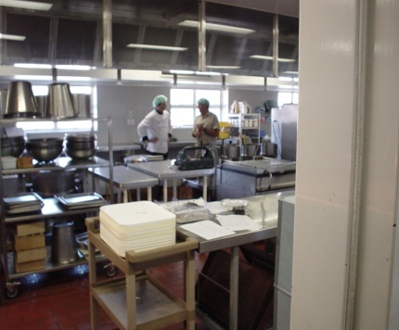
Summary of other catering experience
INDUSTRIAL
HOSPITALS
Millennium Offshore Maritime Industrial Services Co Sharjah Port Authority Khorfakkan Port Camp Crescent Petroleum Co Hercules Marketing Intl Zamil Steel Emirates Cement Al Jaber Energy Services
Zulekha Hospital Gulf Medical College & Hospital Ministry of Health Sharjah Belhoul Speciality Hospital Canadian Hospital

Slide 13
Facilities Management
Non-technical services
Providing reliable, efficient, and high-quality services including
Administrative Support, Landscaping, Maintenance,
Security, Waste Management and Janitorial.
Technical services:
HVAC/Pumps
Plumbing/ Electrical/Painting/Carpentry/Masonry
Water Treatment/Kitchen /Laundry Equipment
Power Generators
Fire & Safety Systems
Maintenance : Heavy Equipment/Vehicles

Slide 14
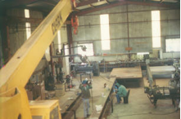
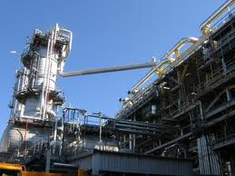
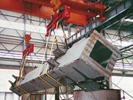
Engineering, Contracting & Maintenance
Major Industries served are
Refinery/Petrochemical/Chemical/Steel/Cement/Glass/Power
Design Consultancy
Project Management Services
Detailed Engineering
Annual Maintenance
Procurement, Supply and Construction (Steel, Mechanical and Electrical & Instrumentation)
Preventive Maintenance

Slide 15
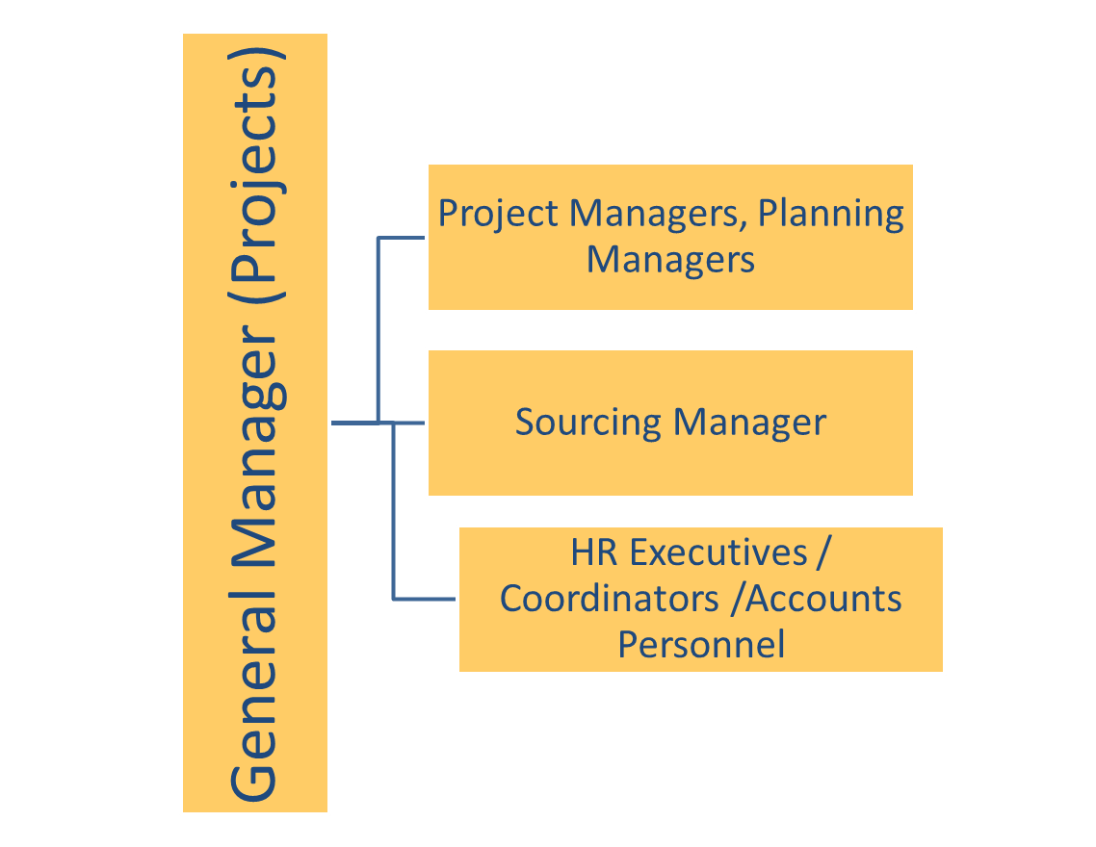
PROJECT TEAM

Slide 16
Engineering CONTRACTING Projects
Indian Oil Corporation: Supply & Erection of Fire Fighting System
Toyo Engineering: Electro-Mechanicals : Flare Stack & Fire Fighting Systems for C2, C3 Recovery at Oil & Natural Gas Corporation Facilities
Haldia Petrochemicals: Erection of 170 MT Reactor and Caustic Tower at over 18 meters and 46 meters height respectively.
Gujarat Fluorochemicals: Fabrication & Erection of structural units, tankages, piping and erection of equipment at the Chemical Plant.
Nirmal LTD: Fabrication, Erection, Testing & Commissioning of Conical Roof Oil Storage Tanks
Tytan Organic Chemicals ME: Expansion of 20kl Chemical Plant
Nakheel Palm Jumeirah: Mechanical, Electrical & Plumbing for 94 Palm Jumeirah Villas
Installation of ground pipe lines for Abu Dhabi Municipality
IG Petrochemical LTD: Dismantling & re-erection of equipment & piping, modification of structure for revamping Phthalic Anhydride Plant.
Jindal Power: Erection & Commissioning of Boiler with supporting structures

Slide 17
Marine Engineering- CREW MANAGEMENT - Ship Chartering
MARINE ENGINEERING
Refit * Retrofit* Steel Renewals* Blasting * Painting
Mechanical Works –Overhaul*Spares*Routine Maintenance for Pumps*Generators*Motors*Derricks*Hydraulic System
Repairs carried out afloat and alongside/ Dry docking
Sludge*Slop Removal & Disposal
Voyage Repairs
SHIP CHARTERING
Largely of offshore fleet viz. Anchor Handling Tugs Offshore Supply vessels Tankers: ULCC, VLCC, Aframax, Panamax Accommodation Barge/Barges
MANNING & CREW MANAGEMENT
Supply of qualified crew complete service including crew planning/training/crew processing/payroll.

Slide 18
CLIENTS
MARINE ENGINEERING
CREW MANAGEMENT
Coast Guard Indian Navy United Arab Shipping-Kuwait Arab Heavy Industries-UAE Bakri Navigation-KSA Arab Ship Repairing Yard-Bahrain Mohammed Al Mojil Group-KSA
Kuwait Oil Company Saipem Gulfmar Offshore-UAE Star Navigation-KSA UASC-Kuwait AMTS-KSA AWALCO-Bahrain Dena Marine-KSA AGMS-Kuwait & KSA ATCO-KSA Reef Navigation-Sweden Zamil-KSA Seaport International-UAE

Slide 19
Information Technology
ESPIRE SYSTEMS PVT LTD
Application Development
Application Management
Infrastructure Management
Mobile Application Development
Software Testing / QA
Packaged Application Services

Slide 20
HRD & Placement Services
INFRASTRUCTURE FACILITIES : Network of offices : 9 in India * 7 in GCC* 5 in SAARC PEOPLE POWER : Qualified and experienced team of Management (MBAs in Finance, HR, and Marketing) Administrative professionals (University Graduates with experience gained from different industries) complement our core-team. This team is ably supported by our line staff in Operation, Resourcing, Data processing, Logistic and Mobilization. JOB PORTAL : JOBS4HUNT.COM & JOBS4HUNT.PH: This gives us the leverage to act swiftly in catering the needs of our principals within the quickest possible time TRAINING CENTRES: Training Centers in India, Nepal, Bangladesh and Colombo

Slide 21
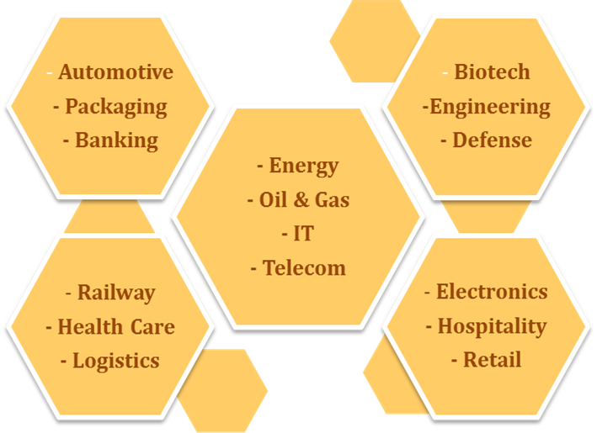
SECTORS SERVED
- Aerospace
- FMCG
- Rigs
- Food & Beverages
- Textiles

Slide 22
Human Resource Development & Placement Services
On average, over 45000 personnel recruited annually for various industries in Construction/Oil & Gas / Petrochemical /Power /Steel /Hospitality /Healthcare Marine & Shipping/Logistics/Defense…..to name a few
Sourcing
Screening, Interviews
Background Checks,Medical
Mobilization

Slide 23
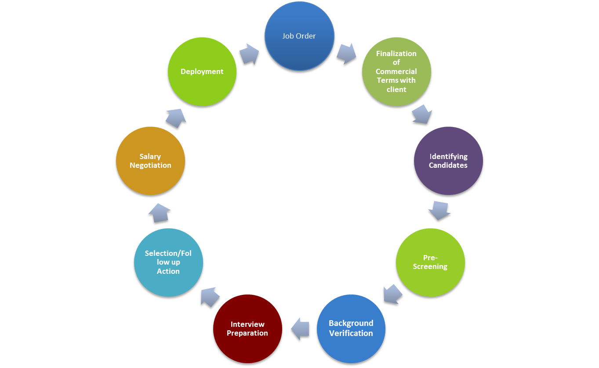
Recruitment PROCESS

Slide 24


JOB PORTAL : JOBS4HUNT.COM
Complementing our Industrial Training – HR Development and Placement activities is our own job portal viz. www.Jobs4hunt.com & www.Jobs4hunt.ph Impressive live data of over 400,000 resume, updated on a regular basis. This further enhances the resourcing capability of MENA in regard to identifying prospects and offering them to clients to meet challenging and critical needs at short notice. Over 18000 candidates gained employment thru’ our job portal since inception in the year 2008. Well recognized for offering seamless employment opportunities in the Arabian Gulf, Africa, CIS and other regions

Slide 25












SOME OF OUR CLIENTS

Slide 26

























SOME OF OUR CLIENTS

Slide 27
CONTACT
MENA Support Service Limited Office No. 14, Options Primo, 21st Road Marol MIDC Industrial Estate, Andheri (East), Mumbai – 400069 Maharashtra, India Tel: +9122 61041786 (20 Lines) Fax: +9122 61041786 E-mail: info@menalimited.com

